Slide 1
Plant Disease Detection Using Supervised Learning with Deep Neural Networks
By Hong Shi And Syed Mohammad Adil

Slide 2
Introduction and Motivation for Project
Main idea is to be able to differentiate between healthy plants and diseased plants using a deep learning model.
Agriculture sector is a major part of GDP for every Country.
Advantages of automating plant disease detection:
Early Detection of disease
Cost effective in terms of time and money
Food/Crop Security

Slide 3
Prior Work
Previously deep neural networks have been used to detect diseases in plants.
However, they are mostly focused on single diseases on a particular type of plant
Variation between plants and multiple diseases are limited.
Most models are trained using transferred learning

Slide 4
Novelty
Our model is a 50-layer Residual Neural Network that has been trained from scratch.
Can accurately differentiate between multiple diseases and plants instead of focusing on a specific type of plant or disease

Slide 5
Dataset
Gathered Data from Plant Village.
Contains 14 different plants and total of 38 classes.
Class includes healthy and various diseases of each type of plant.
Total images 76,000
Train test split -> 80/20
Training data 60,800
Test data 15200

Slide 6
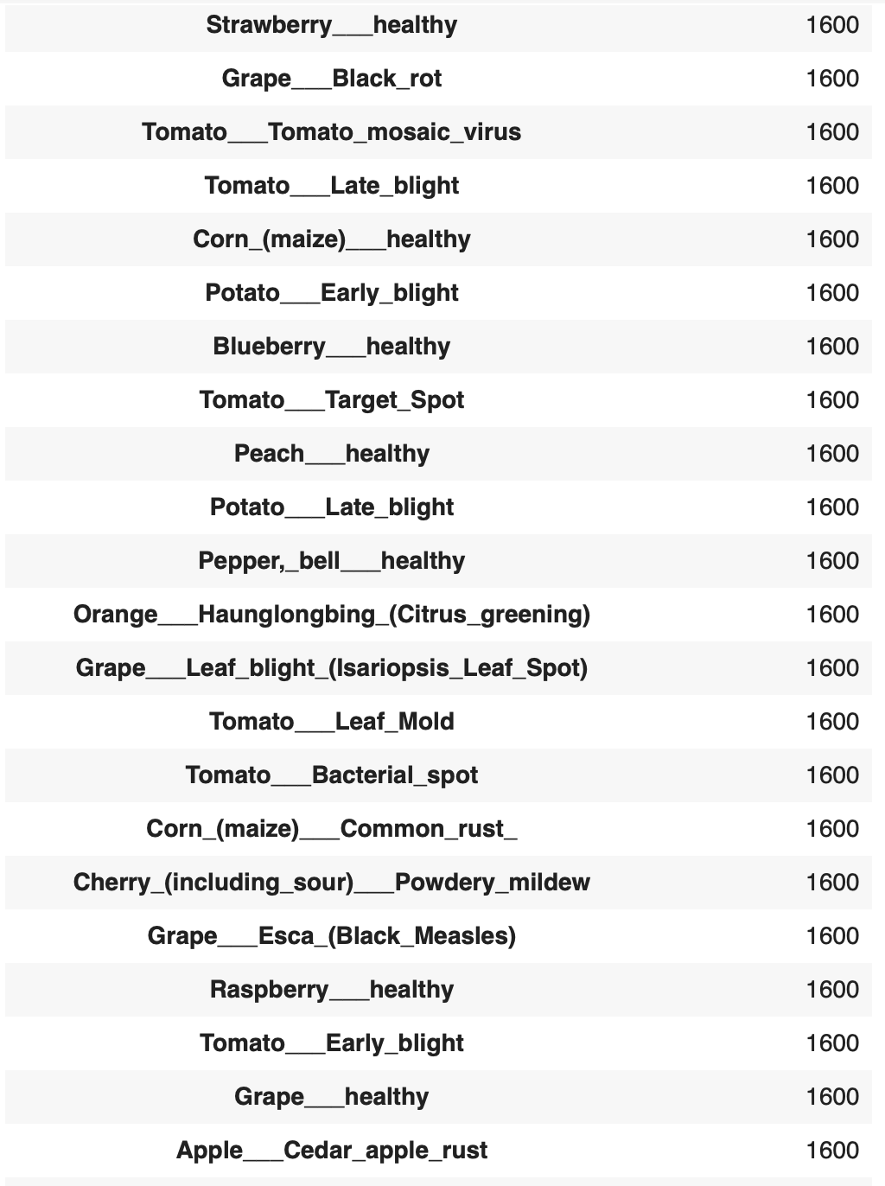
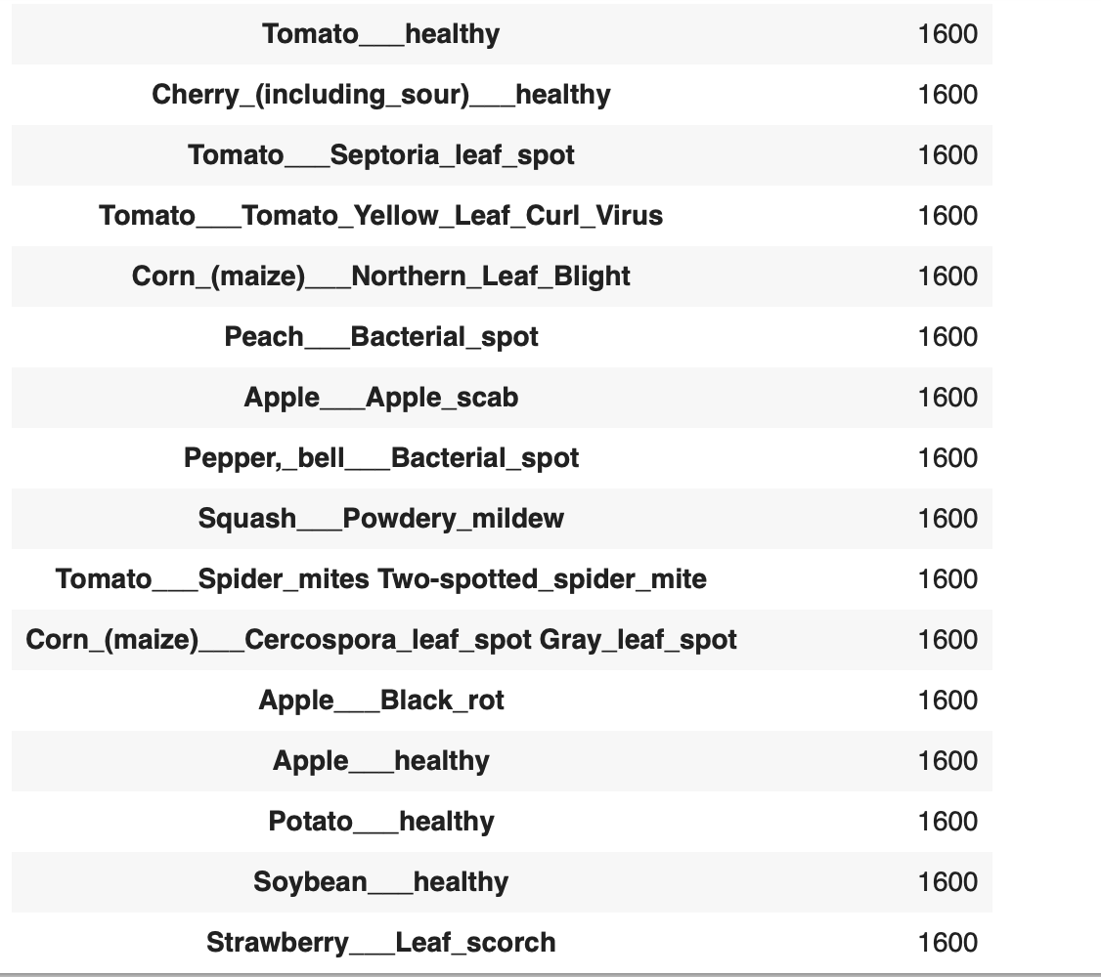
Dataset
Total images for training 60800

Slide 7
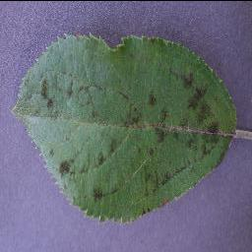
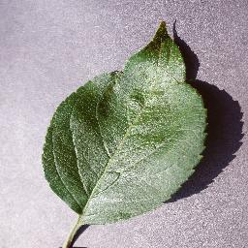
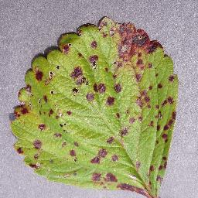
Visualizing Dataset
Apple Scab
Apple Healthy
Tomato Leaf Scorch

Slide 8
Algorithm and Experiments
Model Type
We developed a Residual Neural Network model from scratch to train over the dataset using Tensorflow.
The model consists of 50 layers
Why ResNet
Avoid vanishing gradient problem through skip connections.
Achieves higher accuracy than conventional neural network models
ResNet 50 model is one of the best in image classifications

Slide 9
Algorithms and Experiments
Model Architecture
Starts with convolutional layer (7x7) followed by batch normalization and ReLU activation function.
Output passed through a max-pooling layer (3x3) with a reduce the spatial dimensions.
Followed 8 Residual blocks. Residual blocks filters increased gradually from 64 to 512.
Residual blocks contain 2 convolution layers, batch normalization and RelU activation.
Output of the last residual block is passed through global average pooling and a dense layer with a softmax activation function that produces the output probabilities for each class.

Slide 10
Algorithm and Experiments
Data Augmentation
Rescaling of image pixel values to be between 0 and 1
Increased numerical stability of gradient
Faster Convergence since images are normalized to have a similar scale
Improved generalization to help prevent overfitting
Image Rotation
Range set between 0 and 30
Adds diversity to training data
Increased model robustness

Slide 11
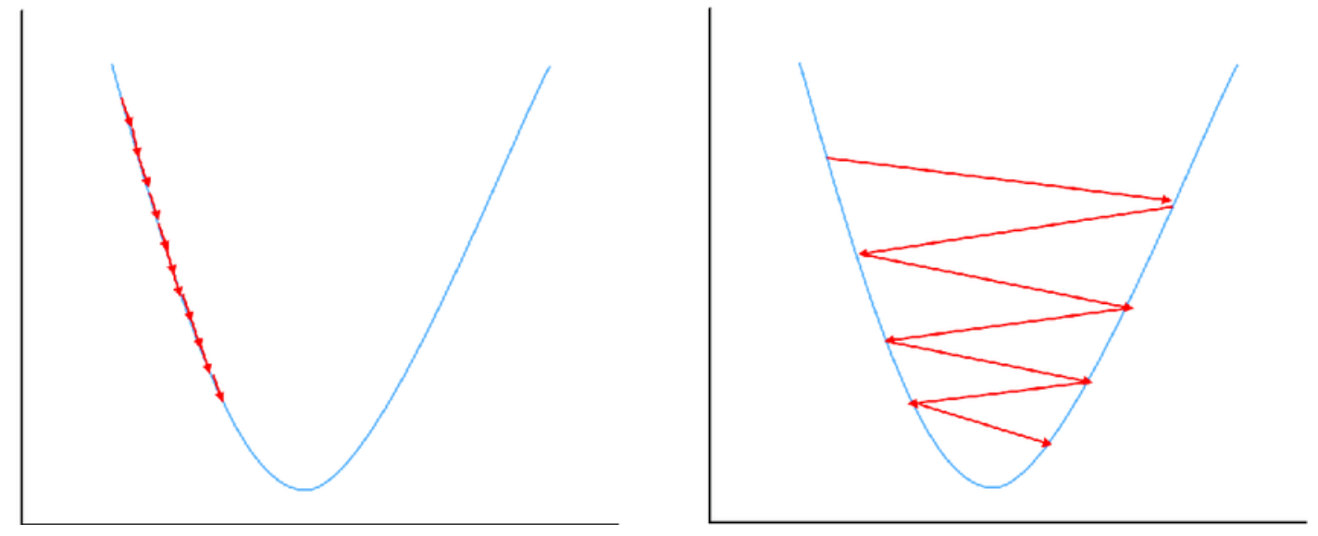
Algorithm and Experiments

Slide 12
Algorithm and Experiments
Learning Rate Scheduler
Deciding on a learning rate is difficult
Low learning rates take too long to converge while higher learning rate may never converge
To overcome this, we created a custom learning rate scheduler in which the learning rate is automatically adjusted during training.
Training epochs divided into 2 parts.
Warm up epochs and Cycle Epoch. 30/70 split
Learning rate changes after every batch
Increased efficiency and accuracy of model

Slide 13
Algorithms and Experiments
Model Training
Total Epochs 10
Warm up epochs 3 -> learning rate increases to maximum value
Cycle Epochs 7 -> learning decreases to minimum value
Maximum value of LR -> 0.01
Minimum -> 0.0004
Batch size 32
Steps per epoch 1900
Training Validation Split 80/20

Slide 14
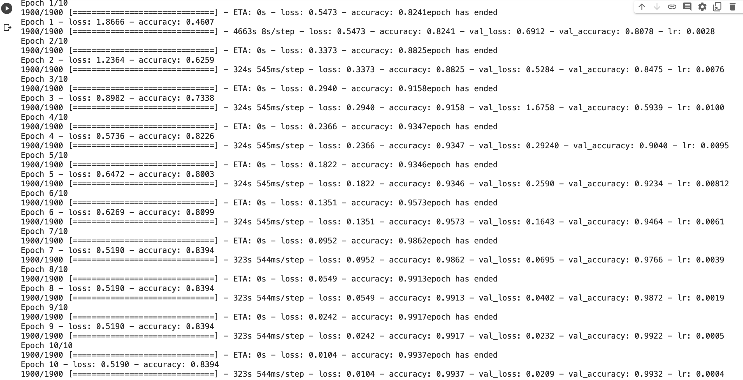
Results
Final Accuracy =➔ 99.32%

Slide 15
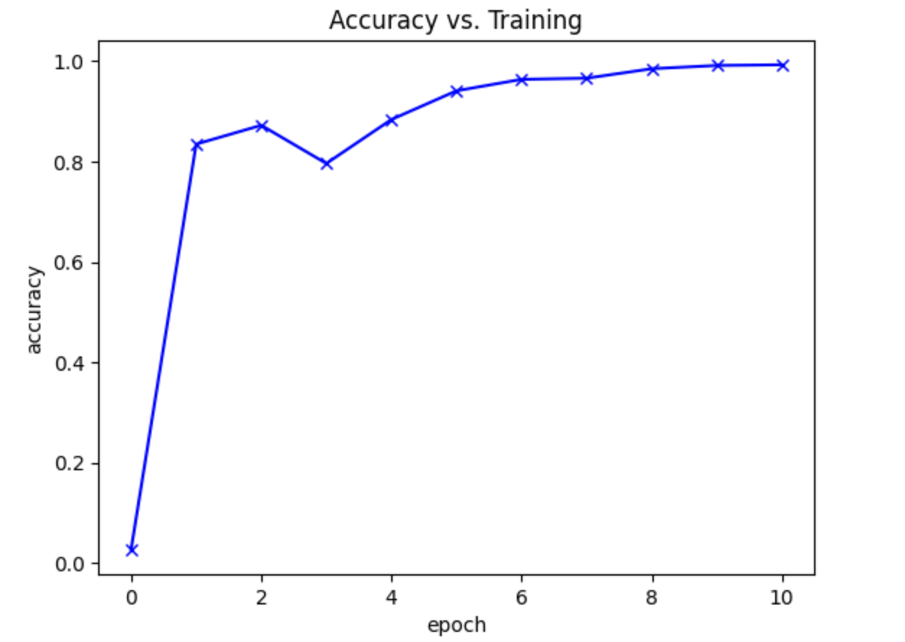
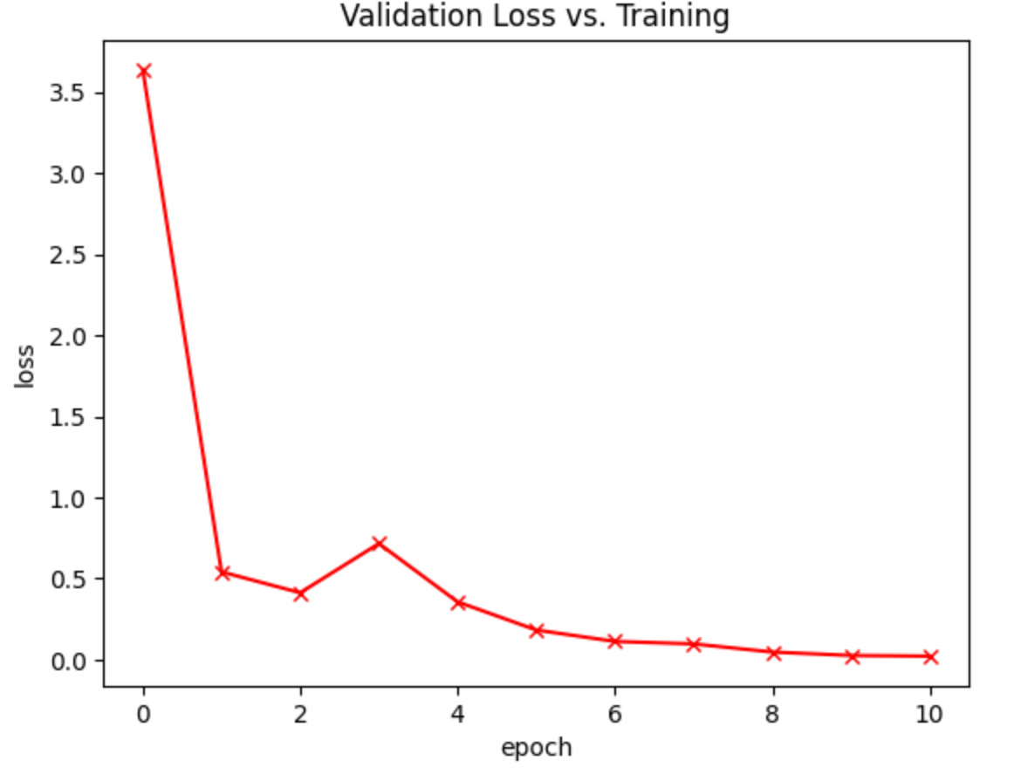
Results

Slide 16
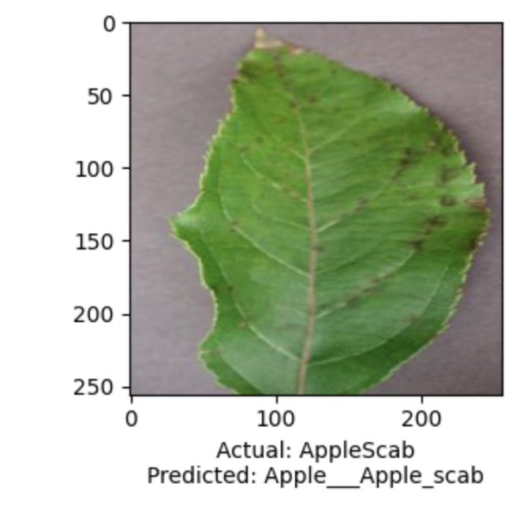
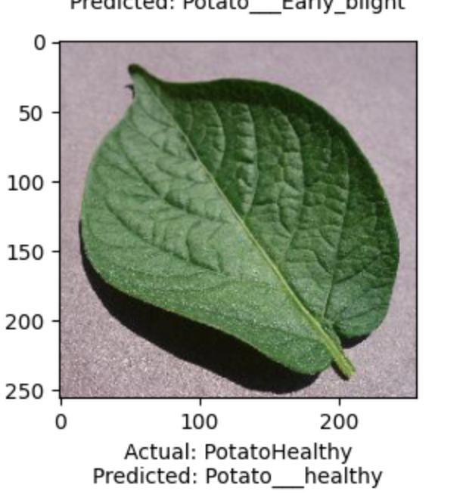
Results

Slide 17
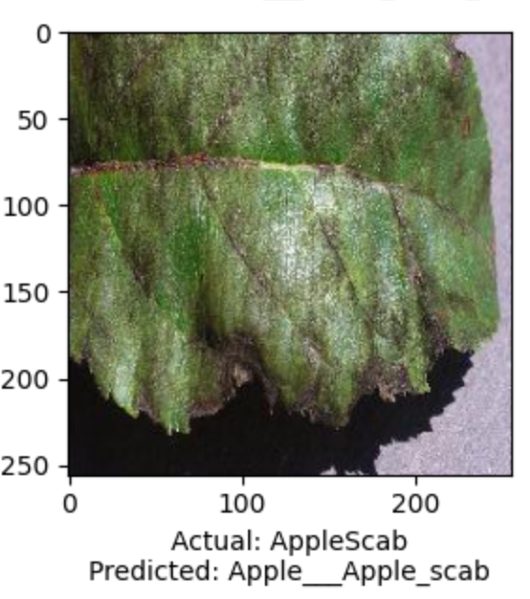
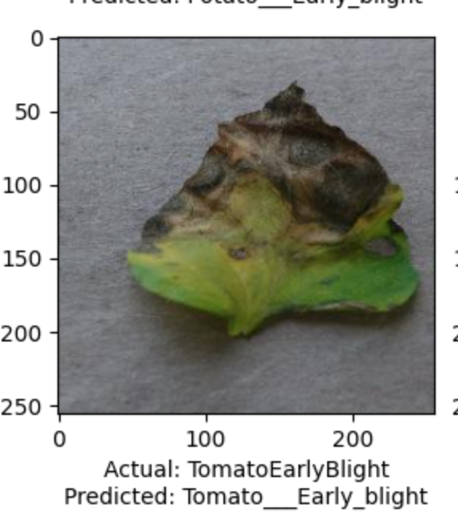
Results

Slide 18
Overall Experience
Learned about different problems associated with training a deep neural networks
Learned how to construct a deep learning model on our own
Learned different algorithms for learning rate scheduling

Slide 19
THANK YOU

